Slide 1
Welcome Back!
Two major tests this semester
STAAR test (January-April)—May 8/9?
AP test (August-April)—May 10
To prepare for AP—what we’ve been doing
To prepare for STAAR—Google Classroom quizzes
Once every week to two weeks
Speaking of quizzes—chapter 23 quiz on Friday! ☺

Slide 2
Politics of the Gilded Age
Period 6: 1865-1898
The American Pageant, Chapter 23

Slide 3
United States, Post-Civil War
Population boom
39,000,000 citizens in 1870
Lag behind Russia and France
Immigration
Lincoln’s promise of a “new freedom”
Reality—Gilded Age

Slide 4
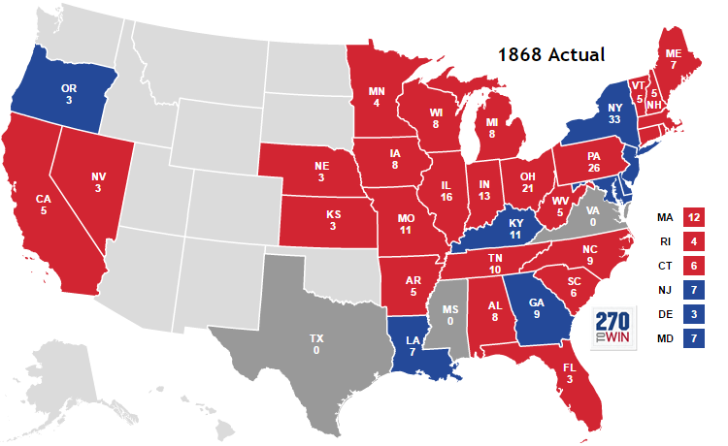
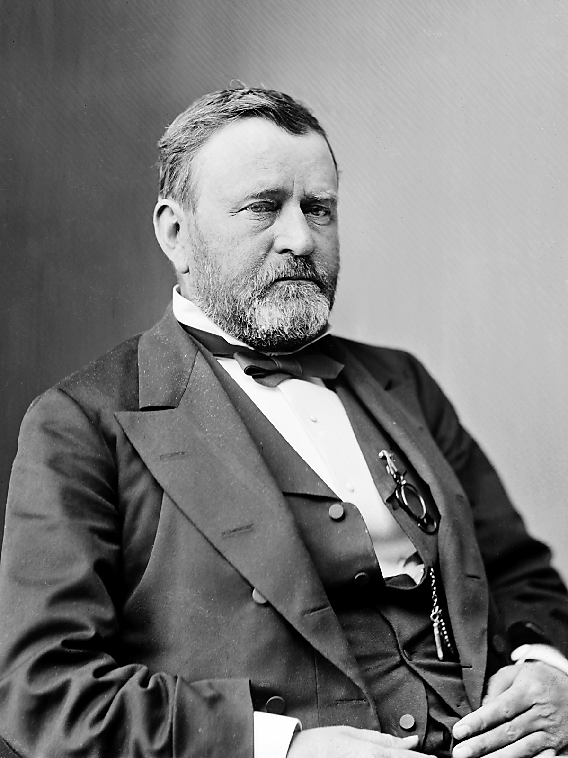
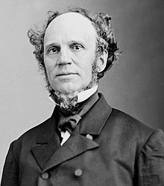
Election of 1868
Congress vs. President Johnson
People are fed up
Look to an outsider
Similar in kind…
General Grant—a one-time voter (D)
Strength—war hero
Weakness—naïve
“Vote as you shot”
They did—barley
15th Amendment’s Role
-Grant v. Seymour
-Southern Concerns: military reconstruction, deflation / $

Slide 5
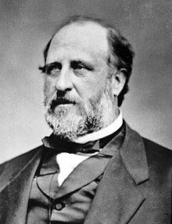
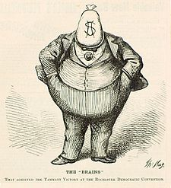
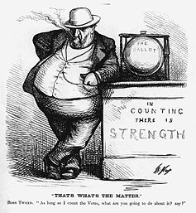
Grant’s Problem
Corruption—business and government
Most are honorable, some aren’t
An honest politician is bought and stays bought
Fisk and Gould, 1869
Gold Market
Whiskey Ring, 1875
Tax evasion (paying half price for the value)
Grant’s secretary involved
Credit Mobilier Scandal, 1867 / 1872
Railroad Scandal
VP involved

Slide 6
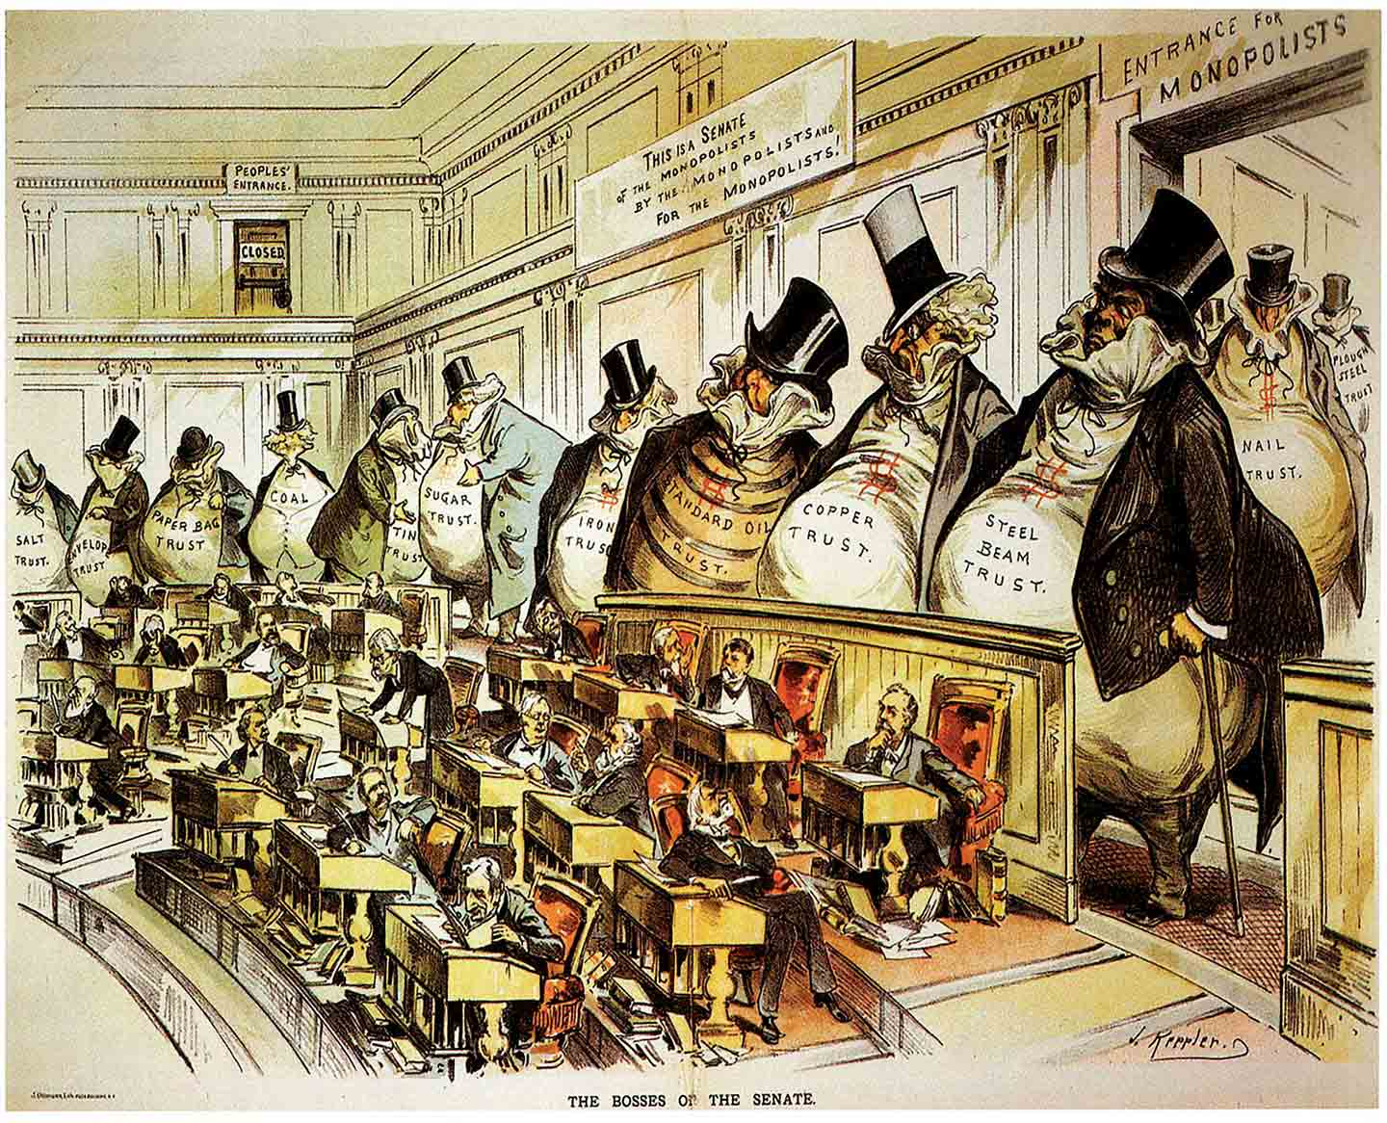

Slide 7
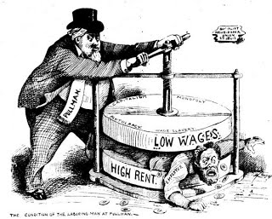
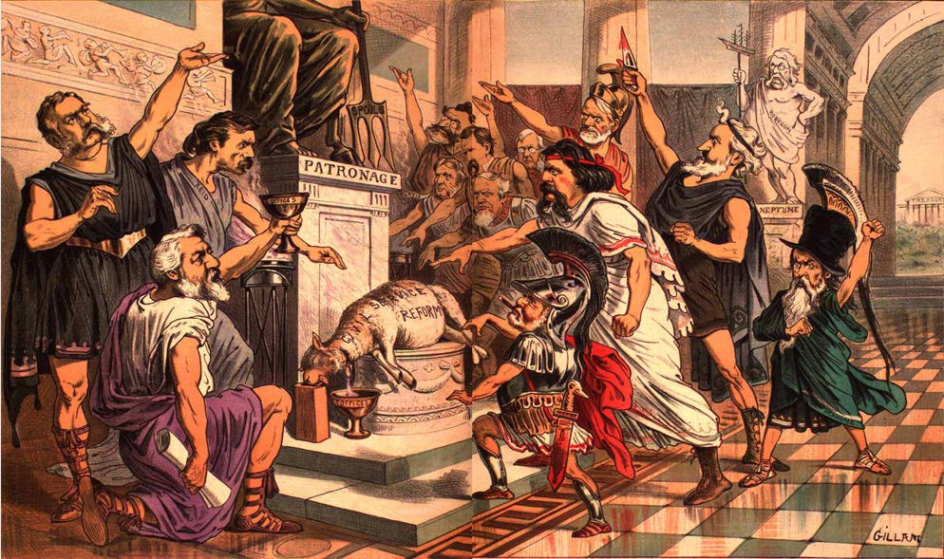
The Party Boss
Boss Tweed
Tammany Hall (Political Machine)
Bribery, graft, fraud
Sources of power
Money
Politicians
Immigrants
Thomas Nast
Pictures. Matter.

Slide 8
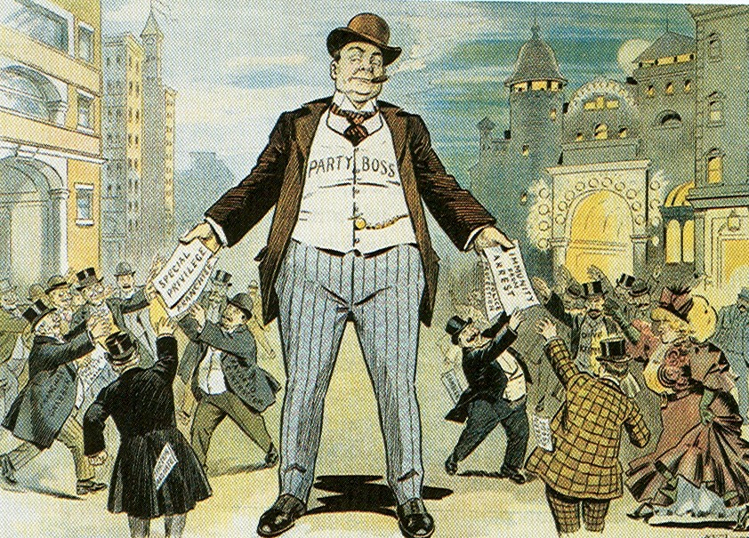

Slide 9
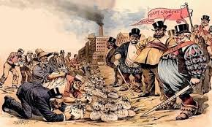

Slide 10
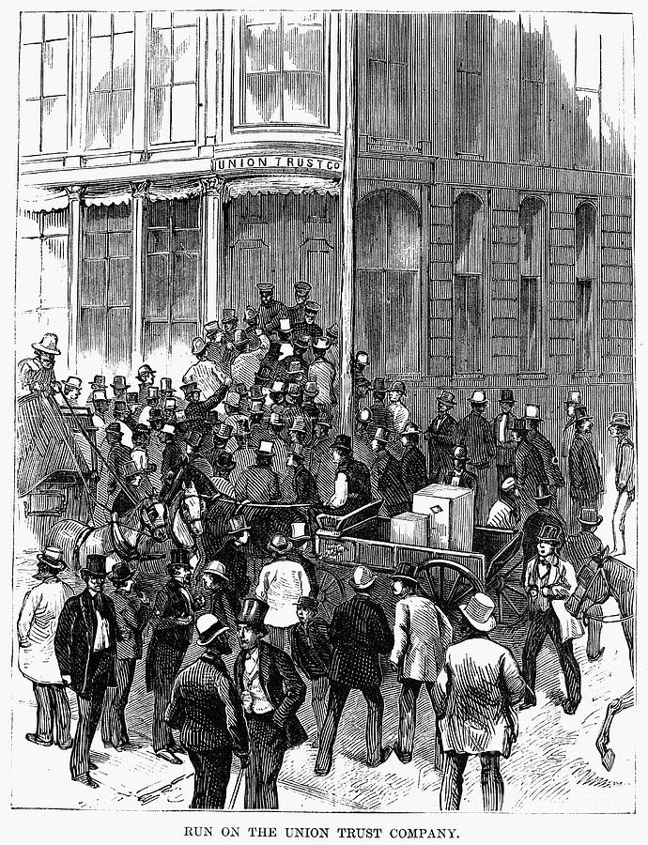
Panic of 1873
Economic collapse
Reconstruction efforts halted
Why? (similar in kind, different in…)
Overproduction—the more you have, …
Overspeculation—banks loan too much money
Poor mainly impacted by it (farmers)
Call for a relaxation of tight money
Hard money vs. paper money
Greenbacks, Gold, Silver
Poor want the greenbacks

Slide 11
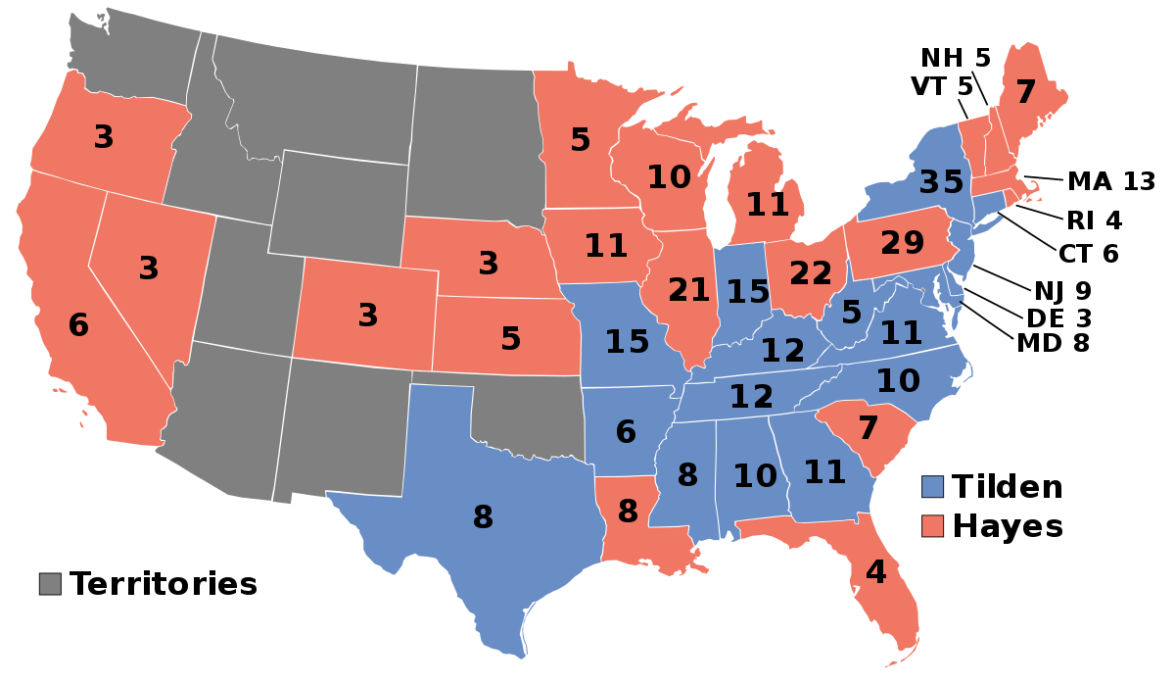
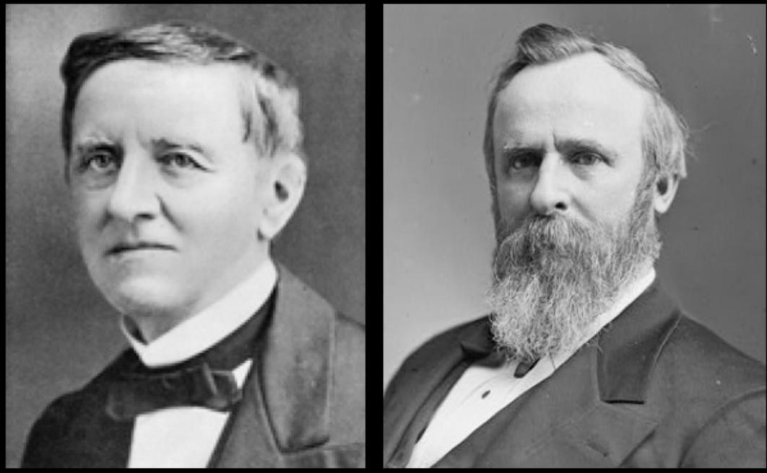
Election of 1876
Hayes (R) v. Tilden (D)
Three southern states contest results
Presidency in question
Compromise of 1877—
Formal end of Reconstruction
South recognize Hayes as President IF
Hayes pulls out last of federal troops from the South
Republicans provide southern politicians with patronage (positions)
Federal aid for a transcontinental railroad in the South

Slide 12
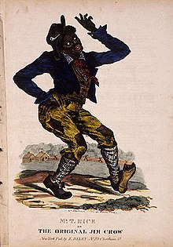
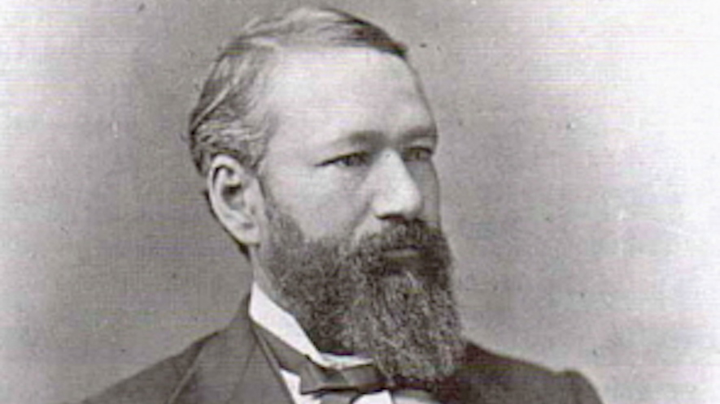
SCOTUS and Reconstruction
Civil Rights Act of 1875—protected rights
Blacks afforded equal use of public spaces
Prohibits discrimination in jury selection
1833—Courts strike it down
14th Amendment only protects against government violations of rights
Translation: discriminate all you want
Jim Crow
**Plessy v. Ferguson—separate, but equal (1896)**

Slide 13
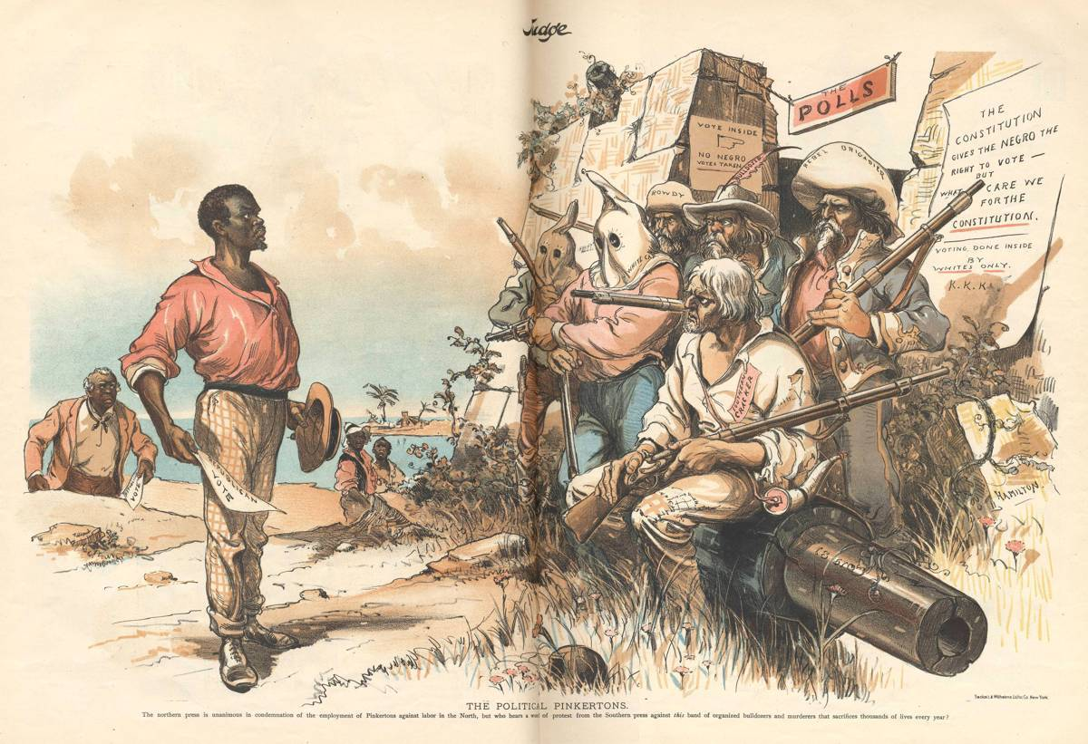
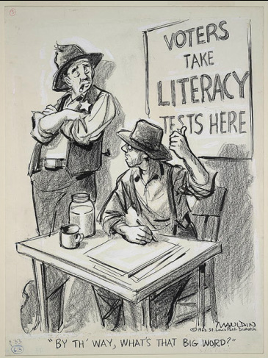
The “New South”
Rebuild, industrialize, and develop the economy
However—still mainly agrarian
Life for African-Americans—difficult
15th Amendment resistance
Grandfather clauses
Democrats dominate the South

Slide 14
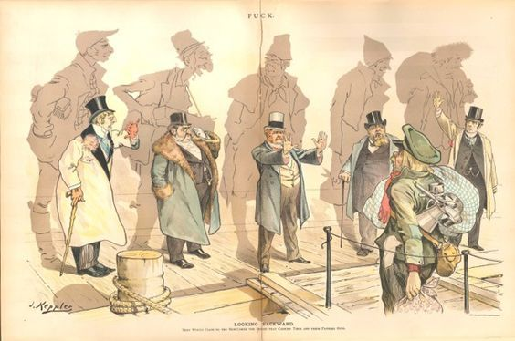
Immigration
Asian and European Immigration
China, Ireland
Jobs and culture**
China—
Immigrants—mine and RR construction
Nativism
Chinese Exclusion Act**
First time immigration restrictions based on race

Slide 15
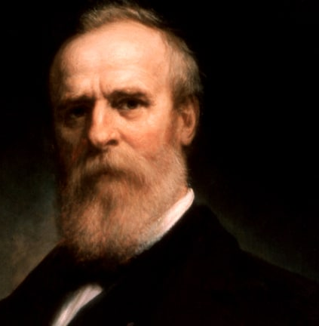
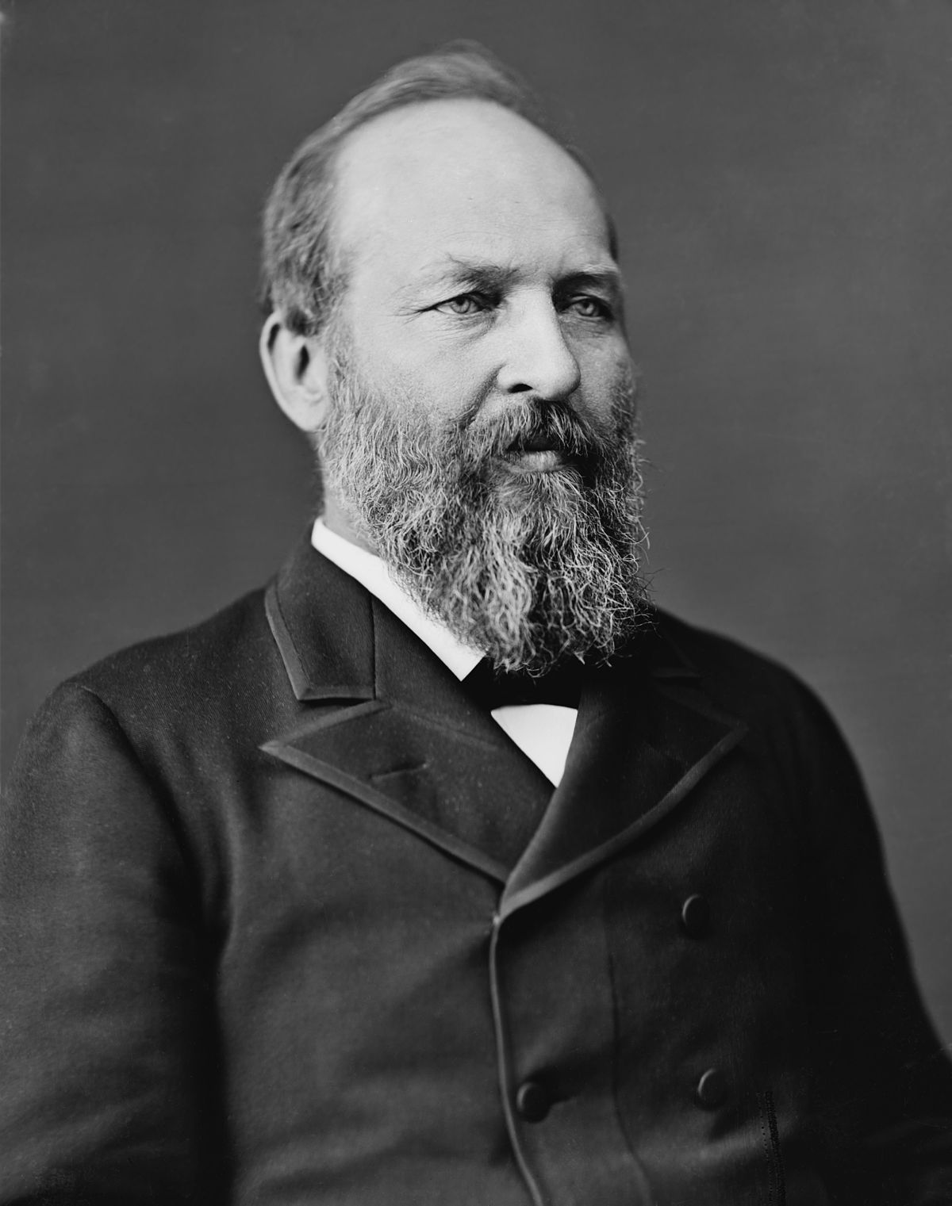
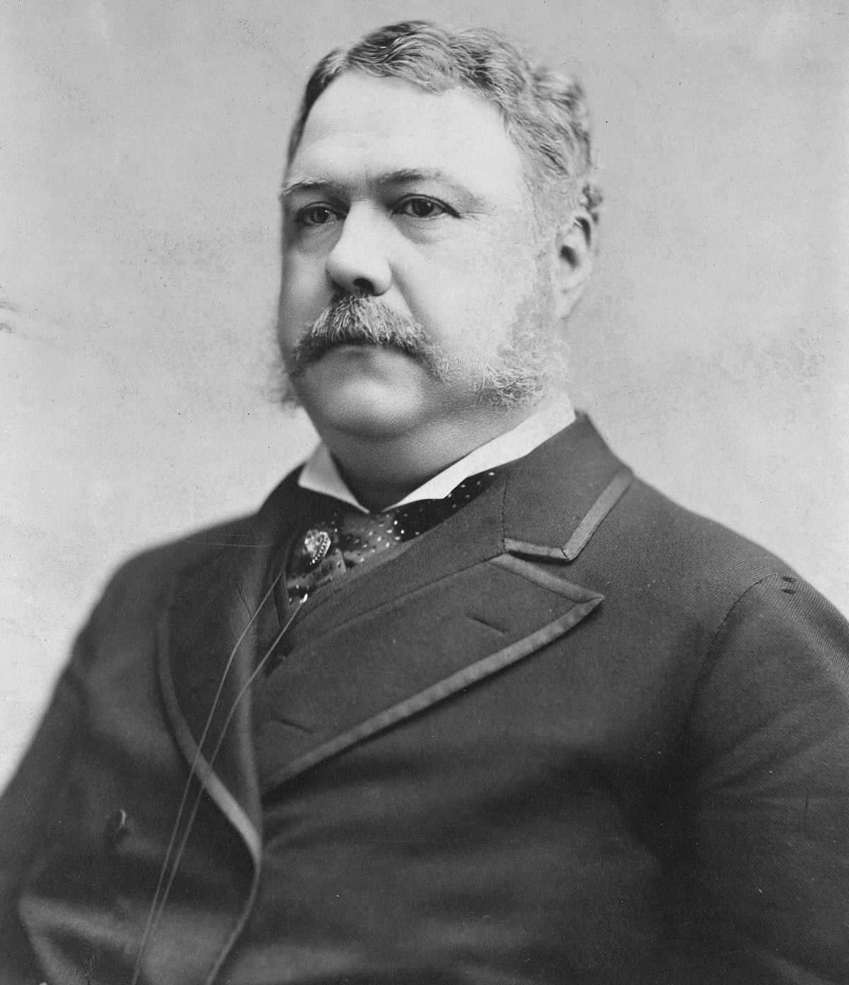
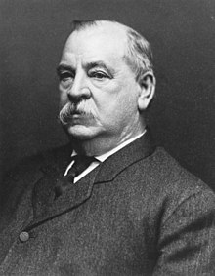
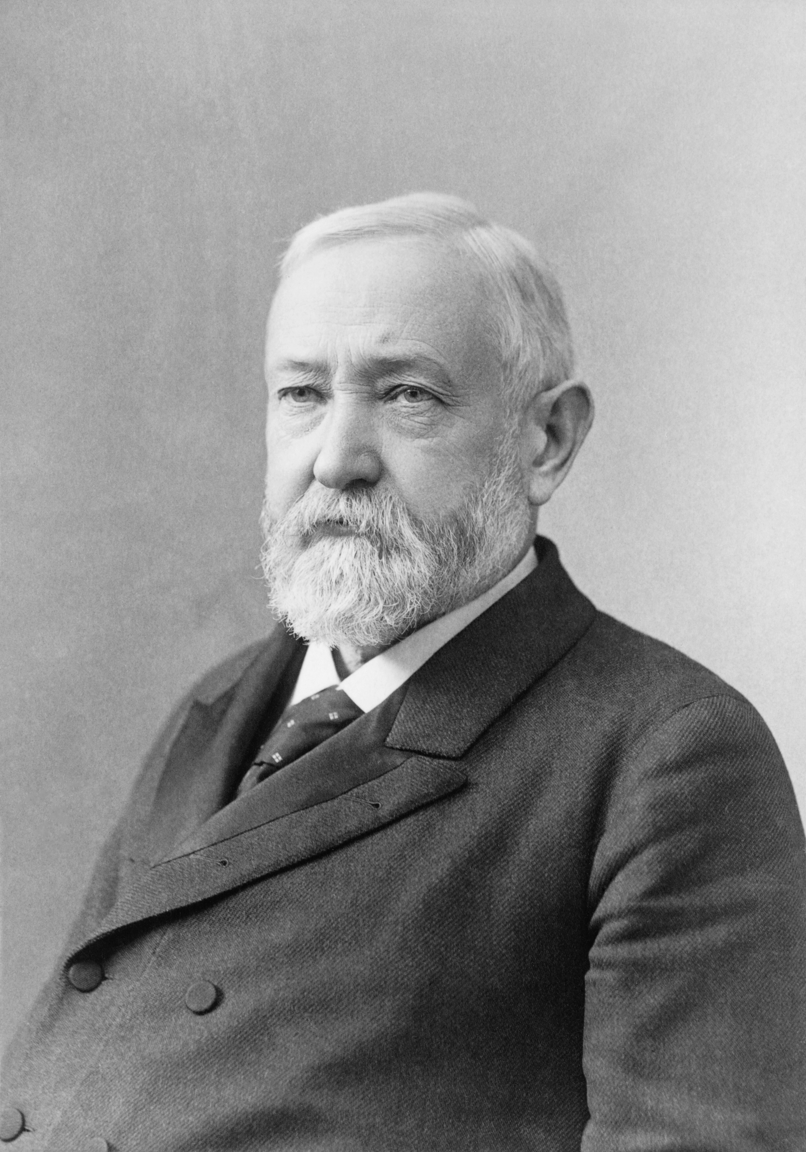
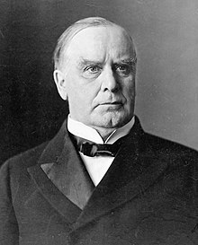
The Forgotten Presidents (1876-1900)
Hayes (R)
Garfield (R)
Assassinated
Arthur (R)
Cleveland (D)
Harrison (R)
Cleveland (D)
McKinley (R)
Assassinated

Slide 16
What do I need to know?
“Gilded Age politics were intimately tied to big business and focused nationally on economic issues such as tariffs and currency policy.”
Huh?
Big business = corruption
Tariffs = Protect American industry
Currency Policy = debates over “hard” money
Both parties are guilty of negligence of the lower classes and minorities
LAISSEZ- FAIRE

Slide 17
Currency, Civil Service and Tariffs
Treasury has huge surplus of money due to tariffs!
Patronage—spoils system (Andrew Jackson)
Civil Service—it’s not what you know…
Plays in to Gilded Age corruption
Half-Breeds
Call for Civil Service
Stalwarts
Support patronage

Slide 18
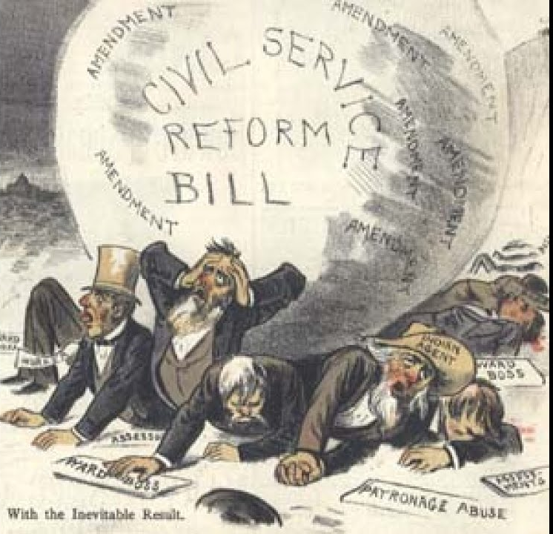
Presidential Politics, 1
Rutherford Hayes
Breaks up unions in the Rail Road Strike**
James Garfield
Assassinated
Chester Arthur supports Pendleton Act (it’s what you know, not who you know)**
Grover Cleveland
Laissez-faire; “The people support the government; the government does not support the people”
Interstate Commerce Act**

Slide 19
Presidential Politics, 2
Benjamin Harrison
Wanted higher tariffs
Grover Cleveland
First and only time non-consecutive, two-term president
A lot more information on these presidents and their policies—we will get to it eventually. This is just the tip of the iceberg.

